Slide 1
Q: Nur 7 der 64 gelieferten Werte geben einem nutzbare Werte zurück.
A: Actually, all 16 selected sensor values are correct (Green). The next slide explains how to read the sensor value.
[[62267 65528 29 62262 32768 32768 32768 32768] [62267 416 379 62262 32768 32768 32768 32768] [62265 124 168 62262 32768 32768 32768 32768] [62265 98 164 62262 32768 32768 32768 32768] [32768 32768 32768 32768 32768 32768 32768 32768] [32768 32768 32768 32768 32768 32768 32768 32768] [32768 32768 32768 32768 32768 32768 32768 32768] [32768 32768 32768 32768 32768 32768 32768 32768]]

Slide 2
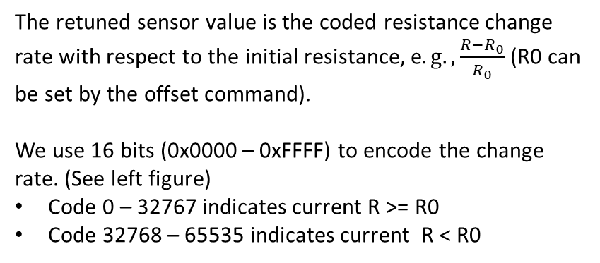

16-bit Code
0x7FFF (32767)
The retuned sensor value is the coded resistance change rate with respect to the initial resistance, e$.g., \frac{R−R_{0}}{R_{0}}$ (R0 can be set by the offset command).
We use 16 bits (0x0000 – 0xFFFF) to encode the change rate. (See left figure)
Code 0 – 32767 indicates current R >= R0
Code 32768 – 65535 indicates current R < R0
0x0000 (0)
0xFFFF (65535)
K is the conversion limitation defined by user, Currently we don‘t provide the command to change it. It is defaultly set to 10. It means only the change rate between -1000% and 1000% is converted. The value out of range is mapped to 0x7FFF or 0x8000 fixedly .
0x8000 (32768)
$$\frac{R−R_{0}}{R_{0}}$$
-K
0
K

